Slide 2

Adapting Security for Cloud, Mobile & Social
Volker Scheuber
Principal Sales Consultant

Slide 3
The following is intended to outline our general product direction. It is intended for information purposes only, and may not be incorporated into any contract. It is not a commitment to deliver any material, code, or functionality, and should not be relied upon in making purchasing decisions. The development, release, and timing of any features or functionality described for Oracle’s products remains at the sole discretion of Oracle.

Slide 4

Agenda
Mobile Security Market
Oracle Mobile Security Vision
Identity Management and Mobile Security
Product Overview and Roadmap
Mobile Workspace Demo
API Security with Oracle API Gateway
API Gateway Demo
Q&A

Slide 5
Agenda
Mobile Security Market
Oracle Mobile Security Vision
Identity Management and Mobile Security
Product Overview and Roadmap
Mobile Workspace Demo
API Security with Oracle API Gateway
API Gateway Demo
Q&A

Slide 6

A NEW EXPERIENCE
THE POINT OF ENGAGEMENT HAS SHIFTED
71%
Influenced to
Purchase by
social media
62%
Fortune 500 deploying
mobile applications
BizChanger Jan 2012
Gartner 2012

Slide 7
Collaborative Work Environment
Mobile Work
Force
Anytime
Anywhere
Social Network Communication
Service Oriented
Tools

Slide 8
IT as a Service
Mobile
Applications
Social Media
Marketing
Self Service
APPS
¹²³⁴⁵⁶⁷⁸⁹¹⁰
¹²³⁴⁵⁶⁷⁸⁹¹⁰
RISK
CONTROL
CHANGING THE WAY WE DO BUSINESS

Slide 9
Privacy
Quality of Service
Data Security & Integrity
Regulatory Compliance
SS #s
Credit Card Info
Personal Profile
Identity Theft
Info Security
Denial of Service
Fraud
Collaboration
Privacy
PII
PCI
PIPEDA
PCI DSS
Directive 95/46/EC
BUSINESS CHALLENGES HAVE EVOLVED
Notes:
Slide 6: The Business Challenges are Evolving
BIG IDEA – business has to think about securing the experience protecting the customer and complying with regulatory mandates
Identity Theft
CRIMINALS ARE AFTER YOUR CUSTOMER DATA… the number of identity theft cases has risen 200% in the past year… just ask Linkedin and Sony. They steal your customer passwords and attack your customers in many ways.
You have to think about quality of service
– CUSTOMERS DON’T BLAME THE CRIMINALS THEY BLAME YOU… just ask Ebay. With all of the Nigerian scams against Ebay users they face a huge customer experience challenge and it challenges their growth. These challenges are directly related to the
You have to think about phishing attacks, man in the middle and man in the browser attacks against your customers.
You have to think of data security
THE BIGGEST RISK TO YOUR CUSTOMER DATA IS INSIDE – DON’T LET YOUR GUARD DOWN. You have to secure the collaboration and put controls in to protect data.
Think of the regulatory burden.
IF YOU DON’T PROTECT YOUR CUSTOMERS THE GOVERNMENT WILL – Every state and nation has different data privacy laws. If you want to capture data on citizens of the European union it better not eave the EU. California recently ruled that a zip code can be considered personally identifiable data and you now have to control who can see it just like social security numbers. If you are not already encrypting credit cards on every interface now is a good time to start. And you have to keep sight of emerging requirements like the Canadian government PIPEDA rule.

Slide 10
Online
Healthcare
Manufacturing
Services
Citizen
Services
Business
Transformation
MOST SIGNIFICANT RE-ARCHITECTURE IN 20 YEARS
Social
Retail
Mobile
Workforce
Cloud
Services
Mobile
Banking
Social
CRM
10
Copyright © 2012, Oracle and/or its affiliates. All rights reserved.
Notes:
Slide 4: The Most Significant Re-Architecture in 20 Years
BIG IDEA – IDENTITY IS TIED TO EVERY MAJOR BUSINESS TRANSFORMATION
The transformation is pervasive across every vertical
Public sector and government – Governments around the world are modernizing systems to provide better access to citizens
Example: State of California will let you renew your drivers license on line and apply for welfare services online
Healthcare – Is a transaction business and depends on the collaboration of patients, providers, payers and hospitals
If you are a payer today .. you transforming to support the Obama care health information exchange requirements You are transforming to provide better service online to compete.
Every manufacturing company has to become a manufacturing services company
Example Rolls Royce has to provide telemetry data from every engine real time.
The applications that power these businesses have to be built on monolithic platforms that do not scale..
The platforms for the modern business will built on
Service Oriented – for flexibility and cohesion
BPM – for collaboration and participation
Big Data – For better business analytics
Fast Data – For the massive scale that will be expected for social, mobile and cloud
ALL OF THIS IS TURNING SECURITY UPSIDE DOWN AND INSIDE OUT.

Slide 11




Mobile & Cloud Computing
90% of CIO expect to deploy more than 25 mobile apps in 2014.
Market for Cloud-based Mobile Apps is expected to grow by 88% from 2009 to 2014
By 2015 mobile app development projects will outnumber native PC projects by a ratio of 4-to-1.
Source: Forbes: Mobile Business Statistics For 2012
Notes:
Source: Forbes:http://www.forbes.com/sites/markfidelman/2012/05/02/the-latest-infographics-mobile-business-statistics-for-2012/
Forbes: The Latest Infographics: Mobile Business Statistics For 2012
Main Points
As we witness this convergence of technologies across mobile, web and things … there are a great deal of new opportunities open to those that can embrace them.
No mobile presentation is complete unless we present a few stats … the numbers are changing so quickly it can be hard to keep up with the latest stats -- let’s take a look at a few:
According to recent Forbes report – 90% of CIO expect to deploy more than 25 different mobile apps in 2014 – just imagine would we ever have said that five years ago – deploying apps typically required a lot more planning and resources but now with Mobile Apps – everyone expects to be able to download and start using it as soon as it is on their device.
Another stat is around Mobile App Development – by 2015 it is estimated that mobile app development will out number native PC development 4 to 1. This introduces a new need to resources that can develop for mobile.
And perhaps as no surprise the demand Cloud-based Mobile Apps is expected to grow by 88% from 2009 to 2014
All of these above stats can be viewed as challenges and opportunities depending on how ready the enterprise is to embrace these trends. Regardless enterprises cannot simply sit back and ignore these changes – these stats will have an impact on everyone.

Slide 12
Mobility Is A Significant Challenge for I.T.
Bring Your Own Device (BYOD) Practices in 2011
Top Mobility Challenges for CIOs
Mobility is Expensive
41%
74% Allow some sort of BYOD usage.
Securing corporate information
41%
74%
CIOs cited Mobility is expensive & a critical challenge
Integrating with other systems
31%
Less than 10% “FULLY AWARE” of the devices accessing their network
Up to$250
10%
per device/ annually
Supporting multiple devices
28%
Includes cost of connectivity, infrastructure and support
Forbes: Mobile Business Statistics For 2012
CIO Insight: Top Challenges of Enterprise Mobility, 2012
McKinsey, 2012: Mobility Disruption: A CIO Perspective
Notes:
Main Point: Just as there are opportunities there are also significant challenges for IT – initially enterprises viewed mobility similar to how they viewed the Web when we first started building our own company websites – essentially everyone wanted to have one but then they realized that whether it is a website or your mobile app the challenge comes when trying to integrate to backend systems, security, and management over time.
Consider some of these stats:
According to a recent study approx. 74% enterprise Allow some sort of BYOD usage however Less than 10% “FULLY AWARE” of the devices accessing their network
And of course it is of no surprise that for CIOs – Security, integration and device and application support remain as top concerns.
Finally the cost associated with Mobility is not trivial – according to this McKinsey report it is estimated that up to $250 is spent annually per each device – this cost includes connectivity infrastructure and support

Slide 13
Organizations Struggle to Secure Mobile Devices
BYOD Is The Norm And Security Measures Are Inadequate
85%
>50%
>70%
85% of organizations allow employees to bring their own devices to work.
- IDG Research Services
More than 50% of organizations rely on their users to protect personally owned devices. - SANS Institute Research Survey
Over 70% of mobile professionals will conduct their work on personal smart devices by 2018. - Forrester
Notes:
BYOD has become the norm and enterprise organizations are looking to employees to secure corporate data.
Mobile use is exploding

Slide 14
Local Password & Local Data
Fraud & Auditing
Phishing & Identity Theft
Denial of Service & SQL Injection
MOBILE
SOCIAL
EMAIL
WEBSITES
MULTIPLE EXPERIENCES WITH MULTIPLE RISKS
14
Copyright © 2012, Oracle and/or its affiliates. All rights reserved.
Notes:
Just to provide a pragmatic picture of the experience and highlight the risk. Here are four experiences you need to think about.
EMAIL –
- This is a key point for identity theft and phishing attacks
Build
RSA was an example of this
WEBSITE
Many customers use the website as their primary source of entry
Build
Watch for cross site scripting m- Bank of fiduram in italy is a good example
MOBILE
Local passwords and data are stored there
BUILD
Hackers can crack this in 360 seconds
SOCIAL
Trust is the big challenge
BUILD
A recent facebook malware stole credit card data
For the phising scam – Oracle OAAM can provide context aware security to detect these types of anomalies.
For the cross site scripting – OAAM can monitor the HTTP session to detect fraud
For the Mobile challenge – Oracle OAM in IDM R2 does mobile sign on to secure mobile apps so passwords are not stored locally
For Social trust challenge – Oracle OAM in IDM R2 provides support for OAUTH to trust sign on from facebook – twitter etc.

Slide 15
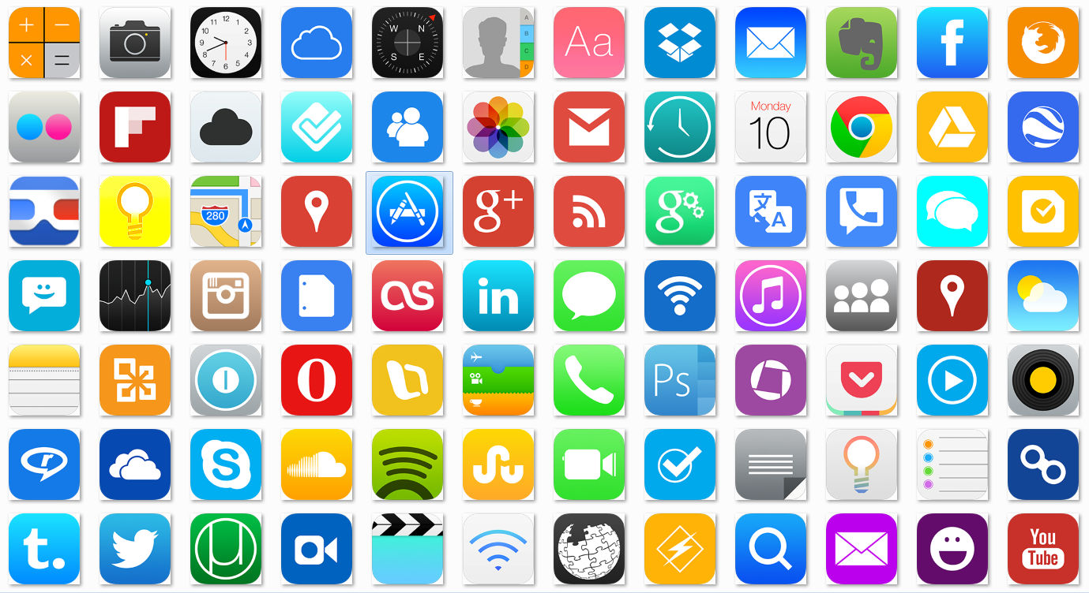
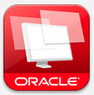



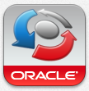

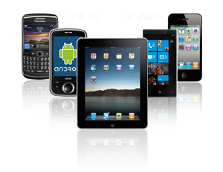
How To Secure Corporate Data In A BYOD World?
Notes:
Mobile devices have become an integral part enterprise and consumer computing; however, securely managing access to corporate apps and data from those devices remains a challenge
Organizations are looking for ways to secure the extended enterprise with solutions that can extend polices and controls to enterprise, cloud and mobile environments

Slide 16

How To Secure Corporate Data In A BYOD World?
Mobile Device Management:
Lock down the phone and treat it as a corporate asset – no personal data
Notes:
Mobile devices have become an integral part enterprise and consumer computing; however, securely managing access to corporate apps and data from those devices remains a challenge
Organizations are looking for ways to secure the extended enterprise with solutions that can extend polices and controls to enterprise, cloud and mobile environments

Slide 17
How To Secure Corporate Data In A BYOD World?
Mobile Application Management:
Create a secure container that separates corporate data and apps from personal
Notes:
Mobile devices have become an integral part enterprise and consumer computing; however, securely managing access to corporate apps and data from those devices remains a challenge
Organizations are looking for ways to secure the extended enterprise with solutions that can extend polices and controls to enterprise, cloud and mobile environments

Slide 18
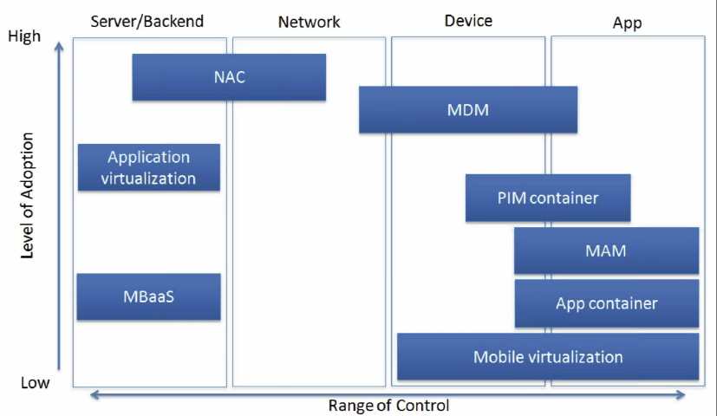
Methods for Managing Enterprise Mobility
NAC: Network Access Control
MBaaS: Mobile Backend as a Service
MDM: Mobile Device Management
MAM: Mobile App Management
PIM Container: Personal Information Manager (email) Container
Source: 451 Group

Slide 19
Agenda
Mobile Security Market
Oracle Mobile Security Vision
Identity Management and Mobile Security
Product Overview and Roadmap
Mobile Workspace Demo
API Security with Oracle API Gateway
API Gateway Demo
Q&A

Slide 20



Oracle Mobile Solutions
Mobile Apps
Mobile Platform
Mobile security
CRM
ERP
B2B

Slide 21










Oracle Mobile Suite
One Platform, Any App, Any Data, Any Device – Secure
Multi-Channel
Native, Web, Hybrid
Maximize existing IT investments
Develop cross platform & multi channel applications
Integrate data and services across the Enterprise and Mobile devices
Secure information uniformly across all layers of enterprise and mobile apps
Deploy & Manage cloud and on-premises for multi-channel delivery
Oracle Mobile Platform
Develop
DEPLOY
Integrate
MANAGE
Secure
CUSTOM Applications
On-Premise Packaged Applications
Cloud
Notes:
More architecture image
Key Points:
From a mobile standpoint, Oracle provides
Extend FMW capabilities for new mobile applications
Excite IT leaders & developers with best-in-class mobile technologies – framework, integration, security
Empower everyone with intuitive mobile business applications
Oracle’s mobile platform simplifies mobile app development providing security across the database, business logic and user interface layers, including authentication, access control, and encryption.
Oracle also provides out of the box mobile apps across all Oracle Applications product lines

Slide 22
What Customers Have Told Us
Secure Mobile Access to Enterprise Apps & Content
Enterprise mobile device use is increasing, BYOD is becoming standard and BYOD requires a user-centric solution (not device-centric)
Securing access to enterprise applications and content presents new security risks, as phones are lost, stolen etc.
Customers seeking solution that separate personal and corporate data and applications
Organizations have a key requirement to secure basic productivity apps and work with bespoke apps
Existing mobile solutions in the market require a complete parallel stack to secure mobile access
Notes:
This slide to state two important points - the others are also good, but can be more concise.
a. Solution needs to separate personal data and applications from corporate.
b. Solution needs default productivity apps and work with bespoke and off the shelf apps.

Slide 23

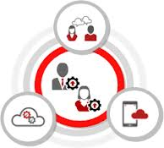



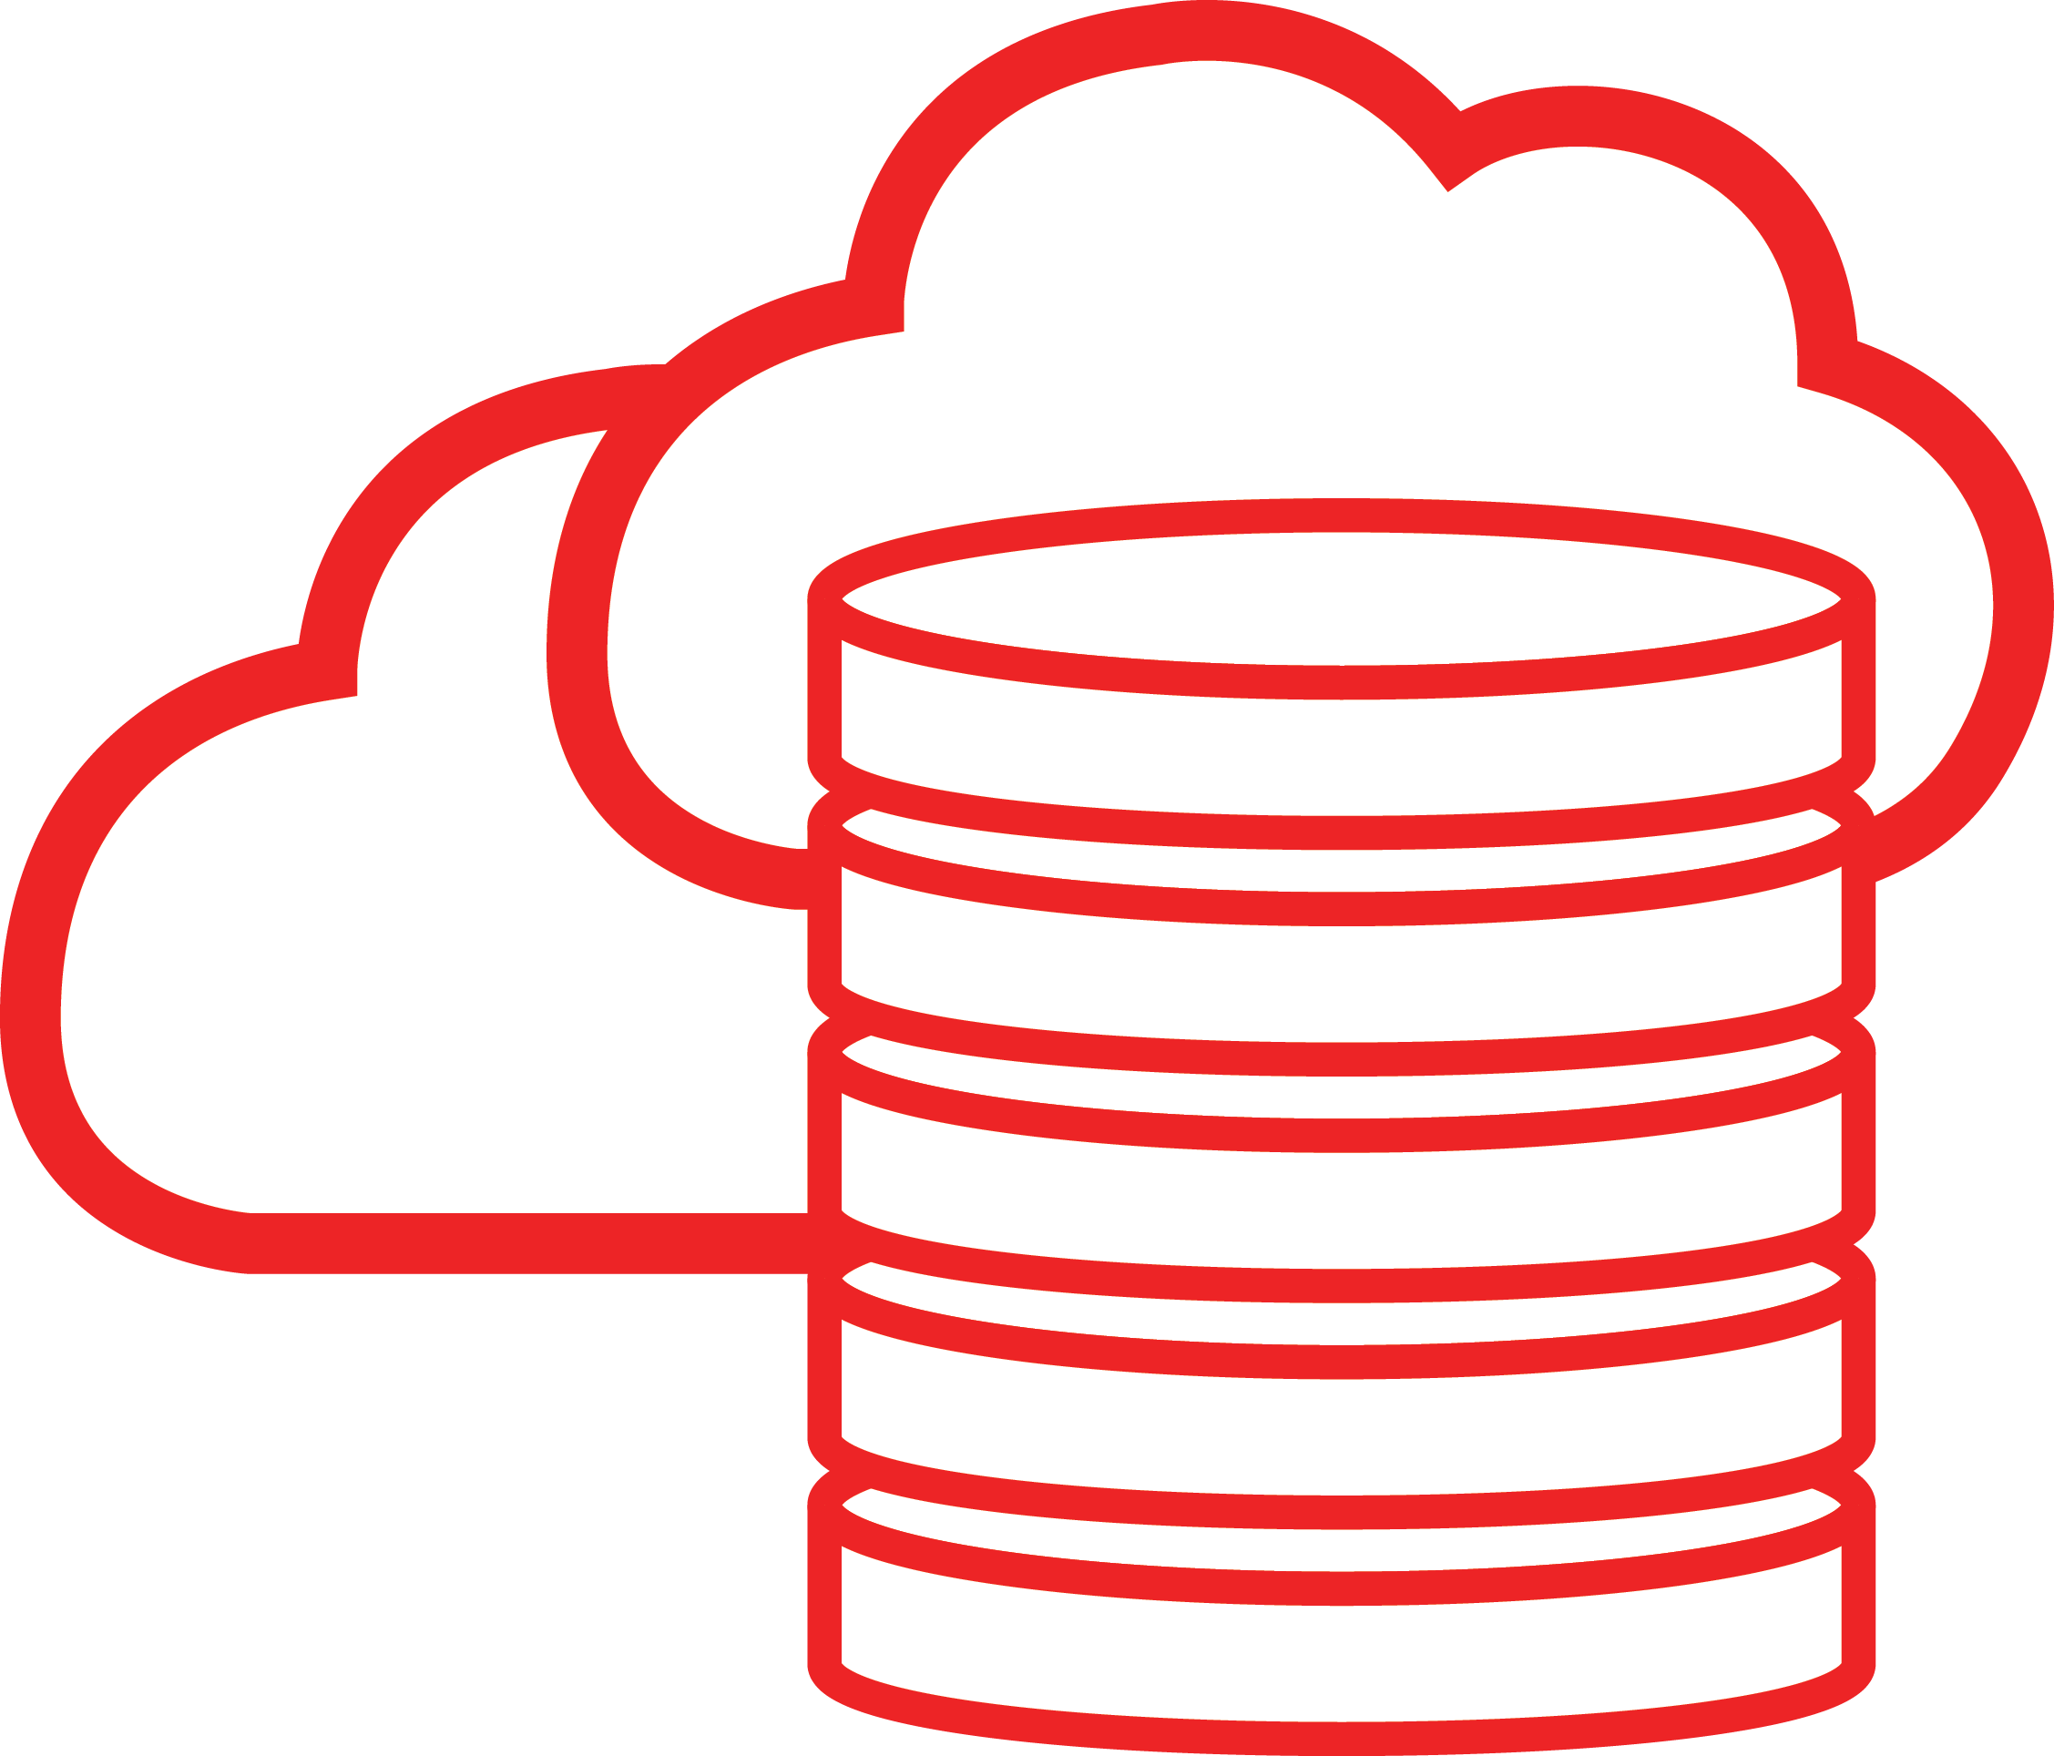

Oracle’s Mobile Security Plan
Securely Separate And Manage Corporate Apps And Data On Devices
Secure Container for App Security and Control
Secure controls and management for enterprise apps
Extend IDM services to avoid redundancy and overlaps
Separate, protect and wipe
corporate applications and data
Strict policies to restrict users from
viewing/moving data out of container
Consistent support across multiple
mobile platforms
Secure communication with enterprise application servers
Corporate app store
Common users, roles, policies, access request, cert etc.
SSO for native and browser apps
Risk/policy based step up and strong authentication

Slide 24
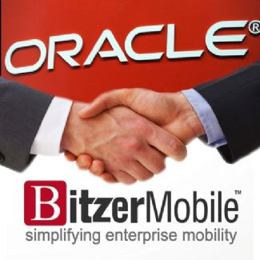
Oracle Acquires Bitzer Mobile!
Sunnyvale, CA-based company, founded in 2010
Focused on simplifying and securing enterprise mobility by offering a MAM solution
Several name-brand customers
[Oil & Gas]
[Large SI]
[Fin Svcs]
[Oil & Gas]

Slide 25
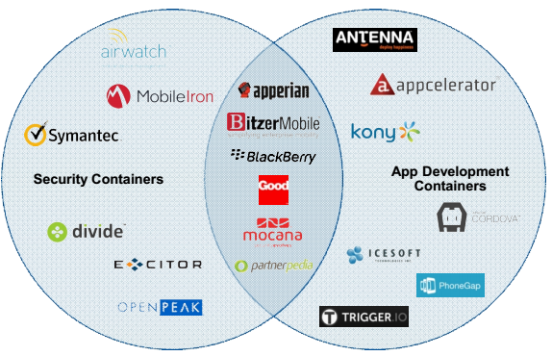


Analysts view of The Container Landscape
Bitzer container brings Security and App mobility best practices
“As enterprises look for ways to manage the threats arising out of BYOC (Bring Your Own Computing), managed workspace products such as Bitzer's can address end-to-end security for content and connection for the authenticated users.”
- Vishal Jain, 451 Research, May 2013
Source: Ken Parmelee, Gartner, June 2013

Slide 26
Agenda
Mobile Security Market
Oracle Mobile Security Vision
Identity Management and Mobile Security
Product Overview and Roadmap
Mobile Workspace Demo
API Security with Oracle API Gateway
API Gateway Demo
Q&A

Slide 27



ENTERPRISE
MOBILE
CLOUD
ACCESS
GOVERNANCE
IDENTITY MANAGEMENT
DIRECTORY

Slide 28







THE EXTENDED ENTERPRISE
A PLATFORM FOR ENTERPRISE, CLOUD & MOBILE
Notes:
IT is facing a lot of challenges. It might seem tough to visualize the solution, given all the demands you’re trying to meet.
IT Operations is already required to “do more with less.” You may be facing a reduction in budgets and staffing, while also trying to deal with increasing requirements on the IT infrastructure.
Meanwhile, everyone expects you to have the agility necessary to meet dynamic business needs quickly and effectively
Basically IT must be able to respond to ever evolving business needs

Slide 29
48%
TAKING A PLATFORM APPROACH:
REDUCES COST
INCREASES PRODUCTIVITY
IMPROVES COMPLIANCE
Cost Savings
46%
More Responsive
35%
Fewer Audit Deficiencies
Source: Aberdeen “Analyzing point solutions vs. platform” 2011
Notes:
Slide 21: Platform reduces cost
Taking a platform approach can save up to 48%
Reduce audit deficiencies by 35%
And make organizations 46% more responsive

Slide 30

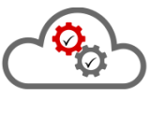

Extended Enterprise Identity Platform
Secure Access Services For the API Economy
Managed Cloud Services For Identity And Access Management
Secure Enterprise Apps And Data On Mobile Devices
Enterprise Identity Automation And Governance

Slide 31
Mobile Security Suite
Separately Managing Corporate And Personal Apps/Data On Mobile Devices
Extending Enterprise Identity Services To Enable Mobile Security with Consistent Policies
Reduce Costs, Reduced Risks And Increased Agility With Platform Approach
Seamless Single Sign-on For Bespoke Applications On Mobile Devices

Slide 32
Agenda
Mobile Security Market
Oracle Mobile Security Vision
Identity Management and Mobile Security
Product Overview and Roadmap
Mobile Workspace Demo
API Security with Oracle API Gateway
API Gateway Demo
Q&A

Slide 33
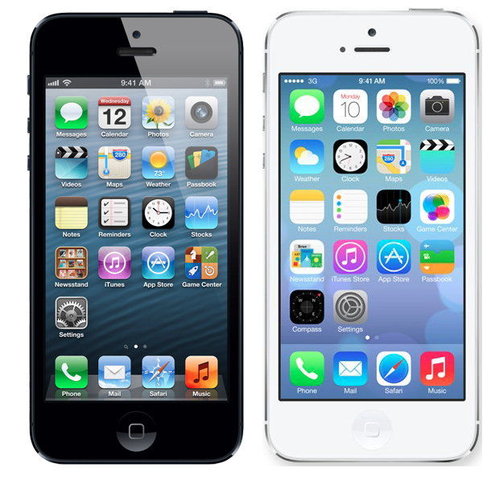
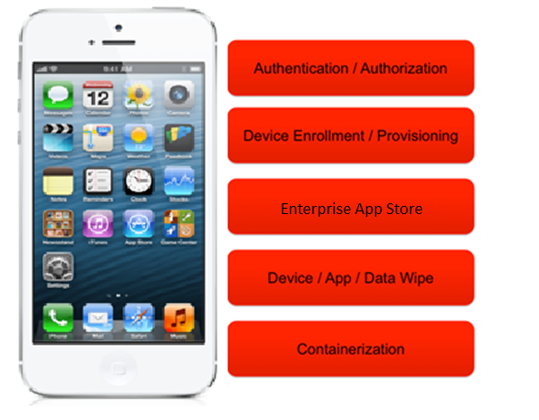
Current Oracle Mobile Security Offering Secure Mobile Authentication/Authorization
Oracle Access Management – “Mobile & Social”
Primarily focuses on bespoke apps
Bridges the gap between mobile devices and IAM infrastructure
Provides authentication, risk-based access, single sign-on and auditing
Supports Web, Hybrid and Native applications
Simplified developer access to these services with mobile friendly interfaces (REST) and iOS & Android SDK

Slide 34
Oracle Mobile Security Vision
Addressing Customer Requirements for Mobile Security
Offer Mobile security suite that can extend the Oracle IDM platform
Separate personal and corporate data
Application centric solution – avoid device lockdown
Extend Identity Management platform to manage the lifecycle of applications and containers
Extend Access Management platform to mobile devices and applications
Oracle/ADF Mobile Apps secure-by-default by consuming these security services

Slide 35
Oracle Identity Management
Extending the Platform with a Discreet Mobile Security Solution
Identity Governance
Access Management
Management
Access Management
Access Request
Approval Workflows
Automated Provisioning
HR Reconciliation
Access Certification and SOD
Role Lifecycle Management
Privileged Account Management
User Management & Self Service
Entitlement Catalogue/App Store
Web Single Sign-on
Federation
Social Identity Access
Externalized Authorizations
SOA and API Security
Integrated ESSO
Token Services
Mobile App Access Management
Secure Mobile Gateway
System Management and
Monitoring
Directory Services
LDAP Storage/ Virtual/ Meta Directory
Device Store
Mobile Security
Device and Container Management
Secure Container

Slide 36

Bitzer Mobile Solution
Complete Protection of Enterprise Information on Mobile Devices
Preserve User Experience
Secure, touch-enabled enterprise workspace for iOS and Android
Trusted workspace for enterprise secure mail, browser, file manager, in-house or 3rd party apps
Single sign-on just like from your desktop
No restrictions or controls over personal apps or data
Increase productivity for mobile workers
Authentication
Encryption at Rest
Encryption in Transit
Enable Enterprise Security and Control
Data Leakage Control
Data leaking control by policy to restrict or allow email, copy/paste, sharing
Isolate enterprise data access from personal data access
Manage application and data lifecycle to ensure users only have access to authorized data
Manage user credential lifecycle
Deployment options include on-premise or in the cloud
Policy Enforcement

Slide 37
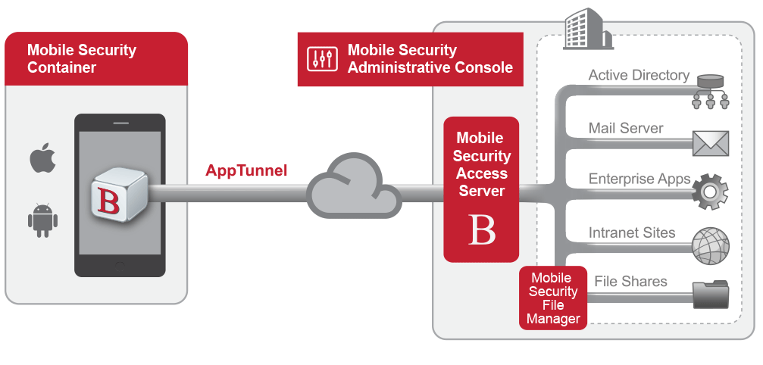
Bitzer Mobile Solution
Component Architecture
Mobile Security Container secures data and enforces DLP
AppTunnel replaces mobile VPN
Mobile Security Access Server supports Windows SSO & 2-factor
Admin Console manages security and authorization policy

Slide 38
Agenda
Mobile Security Market
Oracle Mobile Security Vision
Identity Management and Mobile Security
Product Overview and Roadmap
Mobile Workspace Demo
API Security with Oracle API Gateway
API Gateway Demo
Q&A

Slide 39
Agenda
Mobile Security Market
Oracle Mobile Security Vision
Identity Management and Mobile Security
Product Overview and Roadmap
Mobile Workspace Demo
API Security with Oracle API Gateway
API Gateway Demo
Q&A

Slide 40
Fun Facts
APIs are quickly becoming the application glue for the Web
By end of year 2013
# of mobile connected devices > # people on Earth
Expedia's affiliate network counts $2 billion worth of business a year via APIs
Expedia executives saying that 90% of what they do is business through APIs
Amazon S3 has over a TRILLION S3 objects

Slide 41







API Billionaires Club
…. and the data is dated
 | 13 billion API calls / day (May 2011)
 | 5 billion API calls / day (April 2010)
 | 5 billion API calls / day (October 2009)
 | 1.4 billion API calls / day (May 2012)
 | 1.1 billion API calls / day (April 2011)
 | 1 billion API calls / day (May 2012)
 | 1 billion API calls / day (Q1 2012)
 | 1 billion API calls / day (January 2012)

Slide 42
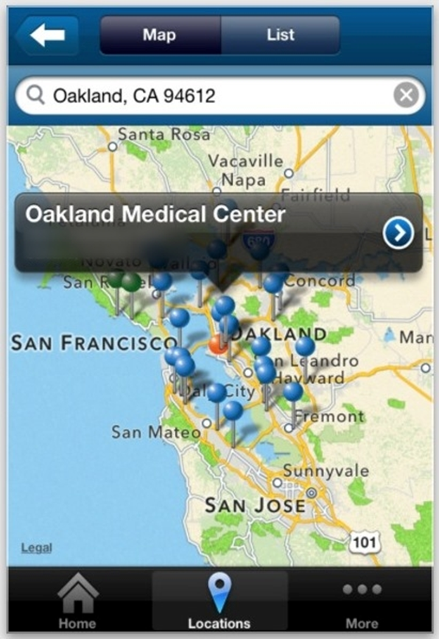
Enterprise API
Support existing systems, processes, & integration
Sensitive data is transmitted
Covered by compliance mandates
Ties to corporate identities

Slide 43
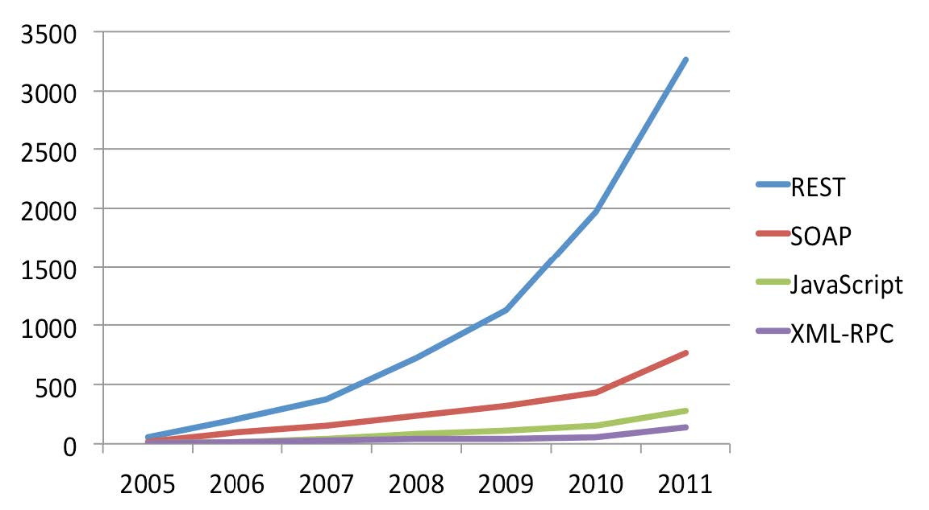
API protocols & styles
9000 - 4/2013
8000 - 11/2012
7000 - 8/2012
3500 - 8/2011
Based on directory of 5,100 web APIs listed at ProgrammableWeb, February 2012

Slide 44
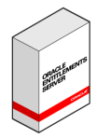



DMZ Security
SOAP / REST/ HTML
Validated message
Web Service
OAG
Browser and API Clients
Dictionary
Format String
Buffer Overflow
Race Conditions
Symlink
Unprotected interfaces
Sniffing
Parameter Tampering
Schema Poisoning
External Entity
Canonicalization
Code templates
Forceful browsing
Directory Reversal
WSDL scanning
Registry Disclosure
Privilege Escalation Attacks
Flooding
Recursive Payloads
Oversized Payloads
Memory Leak
Injection & Malicious Code
Confidentiality Integrity
Reconnaissance Attacks
DOS Attacks
SQL Injection
XPath Injection
Cross-site scripting
Malformed content
Logic bombs

Slide 45
Virtualization, Data/Protocol Bridging
HTTP GET/POST -- REST
SSOToken
OAG
Web Client (Browser)
< weatherreport city=“San Francisco" weather=“42" >< /weatherreport>
SAMLToken
RESTful Web Service
Web Service Client
REST/JSON
Web Service Client
REST/XML
{ "weatherreport" : {"city":“San Francisco", "weather":“42"} }
Required transport and format protocols
SOAP Web Service
Web Service Client
SOAP
Web Service Client
JMS
Data Format Transformations
XML to JSON and vice versa
Protocol bridging
REST to SOAP and vice versa

Slide 46
DMZ Security and Access Control
First Line Of Defense
Web Client (Browser)
HTTP GET/POST -- REST
Web Service Client
REST/JSON
Web Service Client
REST/XML
SOAP/REST Virtual Web Services
OAG
SOAP
Oracle Service Bus
RESTful Web Service
Web Service Client
Web Service Client
JMS
SOAP Web Service
API SSO, Authorization,
XML/WS Security Enforcement at DMZ
WS Authentication, Security token translation, Federation: WS-Security, WS-SecureConversation, WS-Trust (single/multiple STSs).
REST Security: OAuth2, SAML (OIT). Happening on the Gateway.
Protocol Security: XML Security, WS-Security, REST Security
Authorization, Data Redaction, Risk: Leveraging Embedded OES PDP or remote OAM/OES PDP
DMZ
OAM
OES
CA Siteminder

Slide 47








Data security using fine grained authorization
*$#%^*!@
..Card No: 124
Customer Service
Web Applications
Response
- getCustomerDetail
- updateCustomer
- deleteCustomer…
<SOAP:Envelope> … <SOAP:Body> <getCustomerDetailResponse> <customerID> 99999 </customerID> <name> Sally Smith </name> <phone> 555-1234567 </phone> <SSN> 987-65-4321 </SSN> <creditCardNo> 1122 3344 5566 </creditCardNo> <purchaseHistory> … </purchaseHistory> </getCustomerDetailResponse> </SOAP:Body> </SOAP:Envelope>
Web Services Clients

Slide 48





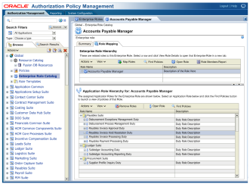
Data security using fine grained authorization
*$#%^*!@
..Card No: 124
Selective Data Redaction of the response payload
OES authz decision returns an “Obligation” with information on what to redact
API Gateway
Customer Service
Web Applications
*$#%^*!@
Response
- getCustomerDetail
..Card No: 124
*$#%^*!@
PEP
- updateCustomer
..Card No: 124
PDP
- deleteCustomer…
Web Services Clients
<SOAP:Envelope> … <SOAP:Body> <getCustomerDetailResponse> <customerID> 99999 </customerID> <name> Sally Smith </name> <phone> 555-1234567 </phone> <SSN> *********** </SSN> <creditCardNo> @^*%&@$#%! </creditCardNo> <purchaseHistory> … </purchaseHistory> </getCustomerDetailResponse> </SOAP:Body> </SOAP:Envelope>
Entitlements Server
isAuthorized(user = Bob Doe, userOrg = Acme Corp userRole = Marketing Manager customerId = 99999 action = getCustomerDetail)

Slide 49










API Key Management
Corporate DMZ
CRM
HR
Unified Agent
API Key +
Web Service Request
Security Gateway
SOAP/REST and Legacy Web Services
Talent
APIKey_AWS
APIKey_Salesforce

Slide 50








Why do you need OAG?
SSO
Authenticated Access
Corporate DMZ
Corporate Network
Database
API Attack Prevention
API Request
App/Device/User Credential
WS SSO
SOAP Request
WS SSO
Fine Grained AuthZ
Throttling
Directory Services (OUD, AD)
Risk/Adaptive AuthN
Oracle Access Management CA Siteminder
Identity Propagation
SOAP/REST and Legacy Web Services
HTTP/REST/SOAP/OAuth Clients
Oracle API Gateway

Slide 51


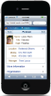



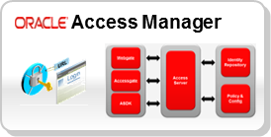
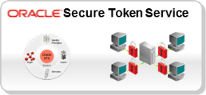
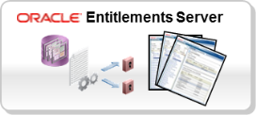

Oracle Web Services and API Security
First Line Of Defense
Shared Services Layer
End Point Security
OWSM Agent
HTTP, SOAP, REST, XML, JMS
HTTP, SOAP, REST, XML, JMS
OES PDP
OWSM Agent
OWSM Agent
Service Bus
WS-Security,
Basic Auth,
Digest,
X509, UNT,
SAML, Kerberos
Sign & Encrypt
WS-Security,
Basic Auth,
Digest,
X509, UNT,
SAML, Kerberos
Sign & Encrypt
OAG
Extranet
Counter External Threat
DMZ
Intranet
Counter Internal Threats
* - Planned Capabilities
Common Policy Model

Slide 52
Agenda
Mobile Security Market
Oracle Mobile Security Vision
Identity Management and Mobile Security
Product Overview and Roadmap
Mobile Workspace Demo
API Security with Oracle API Gateway
API Gateway Demo
Q&A

Slide 53
Agenda
Mobile Security Market
Oracle Mobile Security Vision
Identity Management and Mobile Security
Product Overview and Roadmap
Mobile Workspace Demo
API Security with Oracle API Gateway
API Gateway Demo
Q&A

Slide 54





Join the Community
Twitter twitter.com/OracleIDM
Facebook facebook.com/OracleSecurity
Oracle Blogs Blogs.oracle.com/OracleIDM
Oracle IdM Website oracle.com/Identity

Slide 55

Graphic Section Divider

